Slide 1

32555 – Fundamentals of Software Development

Slide 2
Welcome to 32555 – Fundamentals of Software Development
Your Teaching Team:
Dr. Yining Hu | Subject Coordinator
Yining is a Lecturer in Software Engineering. She works with many SMEs to develop software and AI solutions through student and research projects at UTS.
Contact: yining.hu@uts.edu.au
Dr. Xiaojie (Zoe) Lin | Tutor
Zoe is a full-stack software engineer with an interest in data analysis, specializing in JAVA, R, Python, JavaScript, PHP, Bash, and MATLAB; familiar with AWS.
Contact: Xiaojie.Lin@uts.edu.au
Dr. Farshid Keivanian | Tutor
Dr. Farshid Keivanian is an experienced university lecturer and researcher with a PhD in Information Technology. He has over 15 years of teaching experience across Australian institutions, specialising in software engineering, data science, AI, and cybersecurity.
Contact: Farshid.Keivanian@uts.edu.au
Yong Pov | Tutor
Yong is a full-stack software engineer with experience in React, JavaScript, TypeScript, Java, Python, SQL, and AI-assisted learning platforms.
Contact: Yong.Pov@uts.edu.au

Slide 3
Welcome to 32555 – Fundamentals of Software Development
Cmp1 # | Location | Time | Tutor
01 | CB11.B1.400 | Fri 16:00-18:00 | Xiaojie (Zoe) Lin
07 | CB11.B1.401 | Wed 10:00-12:00 | Farshid Keivanian
08 | CB11.B1.400 | Fri 12:00-14:00 | Yong Pov
09 | CB11.B1.103 | Wed 16:00-18:00 | Farshid Keivanian
10 | CB11.B1.401 | Wed 12:00-14:00 | Farshid Keivanian

Slide 4
Classes and Objects
What is a Class?
A class is a blueprint for creating objects.
It defines attributes (data) and methods (behaviours).
Class names are nouns (e.g., Student, Account, CreditCard).

Slide 5
Classes and Objects
What is an Object?
An object is a real-world instance of a class.
Objects exist at runtime and store their own data.

Slide 6
Classes and Objects
Real-World Analogy:
Class = Recipe
Object = Cake made using that recipe
Australian Example:
Class: Koala
Object: A koala named “Koko” at Taronga Zoo

Slide 7
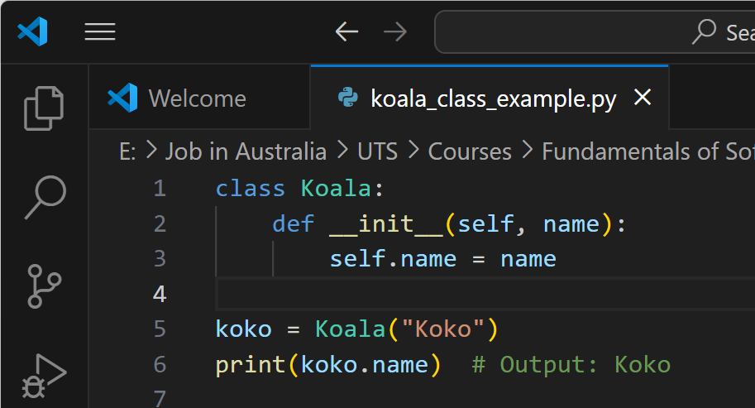
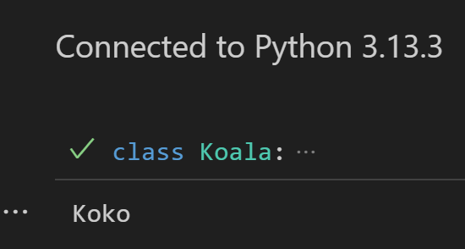
Koala Class Example in Python
This code defines a class called Koala with a name attribute. It then creates an object koko from the class and prints its name.

Slide 8
Activity 1: Add a New Attribute and Print It
Task: Modify the Koala class to include an additional attribute called age. When creating a koala object, assign both name and age, and then print both.
class Koala:
def __init__(self, name, age):
self.name = name
self.age = age
koko = Koala("Koko", 4)
print(f"Name: {koko.name}, Age: {koko.age}")
Learning Outcome: Understanding how to add and initialize multiple attributes.

Slide 9
Activity 2: Add a Method to Display a Greeting
Task: Add a method to the Koala class called greet() that prints a custom message using the koala’s name. Then call this method on an object.
class Koala:
def __init__(self, name):
self.name = name
def greet(self):
print(f"G'day! I'm {self.name}, the koala.")
koko = Koala("Koko")
koko.greet()
Learning Outcome: Understanding how to define and use instance methods.

Slide 10
Object-Oriented Paradigm Principles
What is OOP?
It’s a way of writing code by thinking in terms of real-world objects.
These objects can have data (like properties) and actions (like behaviours).
OOP helps us build programs that are easier to understand and maintain.

Slide 11
Object-Oriented Paradigm Principles
4 Main Ideas in OOP (AEIP)
Principle | What it Means (Simple) | Real-Life Example
Abstraction | Hide the messy stuff and show only the basics | Coffee machine – you press a button, not worry how it works
Encapsulation | Lock the data inside and control who sees or changes it | Medicine sealed in a capsule
Inheritance | Share code from one class to another | Kids inherit their parents’ eye colour
Polymorphism | One word, different actions depending on the object | “Play” button on Spotify vs. radio

Slide 12
Abstraction
What is Abstraction?
It means hiding the complicated parts of something.
You only show what’s needed, not how it works inside.
It helps people use things easily without getting confused by the details

Slide 13
Abstraction
Two Types of Abstraction:
Data abstraction → Hide the variable itself, just show the value (e.g., you see your bank balance, not how it's stored in code)
Function abstraction → Hide the code, just use the function (e.g., use withdraw() without seeing how it works inside)

Slide 14
Abstraction
Real-World Example (Australia):
When you use an ATM, you don’t care how it connects to your bank. You just enter your PIN, choose an amount, and get your cash. That’s abstraction — using it without knowing the details.

Slide 15
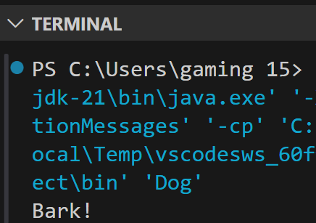
Using Abstraction in Java with Animal Example
abstract class Animal {
abstract void makeSound();
} class Dog extends Animal {
void makeSound() {
System.out.println("Bark!");
}
public static void main(String[] args) {
Dog dog = new Dog(); // Create an object of Dog
dog.makeSound(); // Call the method
}
}
This code shows how abstraction works in Java using an abstract class called Animal.
The Dog class extends Animal and provides its own version of the makeSound() method. The main() method creates a Dog object and calls its sound method to print "Bark!".

Slide 16
Using Abstraction in Java with Animal Example
abstract class Animal {
abstract void makeSound();
} class Dog extends Animal {
void makeSound() {
System.out.println("Bark!");
}
public static void main(String[] args) {
Dog dog = new Dog(); // Create an object of Dog
dog.makeSound(); // Call the method
}
}
In short: It hides the general idea (makeSound) in the Animal class and lets the Dog class decide how to make the sound — this is abstraction in action.

Slide 17
Encapsulation
What is Encapsulation?
Put data and functions together in one class
Hide the details (like private variables)
Let other parts of the program access the data safely using public methods
Keeps things safe, simple, and easy to manage

Slide 18
Encapsulation
Real-Life Analogy:
A capsule pill hides the medicine inside. You can take it, but not open or change it.
Australian Example:
You can see your Opal card balance — but you can't change the balance yourself.

Slide 19
Encapsulation Example Account in Python
class Account:
def __init__(self, balance):
self.__balance = balance # Hidden (private)
def get_balance(self):
return self.__balance # Safe way to access balance
This code shows encapsulation by keeping the balance private and allowing access through a safe get_balance() method.

Slide 20
Inheritance
What is Inheritance?
One class gets features (methods and variables) from another
Helps you reuse code instead of writing it again
Makes programs easier to manage and extend

Slide 21
Inheritance
Real-Life Analogy:
A Cashier is a Person. A Manager is also a Person. They all share things like name and age but have their own tasks too.
Rules:
A child class can use everything from its parent class
It can also change or add its own methods

Slide 22
Inheritance kangaroo example in Java
class Animal {
void eat() {
System.out.println("Eating...");
}
}
class Kangaroo extends Animal {
void jump() {
System.out.println("Jumping...");
}
}
This Java code shows inheritance, where Kangaroo inherits the eat() method from the Animal class and adds its own jump() method.

Slide 23
Inheritance kangaroo example in Java
class Animal {
void eat() {
System.out.println("Eating...");
}
}
class Kangaroo extends Animal {
void jump() {
System.out.println("Jumping...");
}
}
This code defines the classes, but does not run anything because there’s no main() method.

Slide 24
Inheritance kangaroo example in Java
public class Main {
public static void main(String[] args) {
Kangaroo k = new Kangaroo();
k.eat();
k.jump();
}
}
To Produce Output, Add a main() Method:

Slide 25
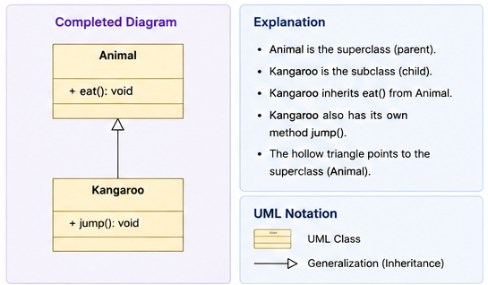
UML Class Diagram for the Java inheritance example with Animal and Kangaroo

Slide 26
UML Class Diagram for the Java inheritance example with Animal and Kangaroo
In UML class diagrams, it is better to include the method name, its parameters, and its return type using this format:
+ methodName(parameterList): returnType
So we write
+ jump(): void

Slide 27
UML Class Diagram for the Java inheritance example with Animal and Kangaroo
Same for eat():
It just prints "Eating...", it doesn’t return anything.
So we label it void (same as in Java code).
It means:
+ → The method is public (accessible from outside the class)
jump() → This is the method name with no parameters
void → The method does not return any value
+ methodName(parameterList): returnType
So we write
+ jump(): void

Slide 28
UML Class Diagram for the Java inheritance example with Animal and Kangaroo
Summary: We use void in UML for the same reason we use it in Java — to show that the method does something but does not give anything back (like a number or string).

Slide 29
Key Differences in UML When Representing Python
The structure of a UML class diagram is the same, whether we're using Java, Python, or another object-oriented language.
Key differences in UML when representing Python:
Feature | Java Style | Python Style
Access modifiers | + (public), - (private), # (protected) | Python has no true enforcement — use _ (protected), __ (private by convention)
Return types | Required (e.g., : void, : int) | Optional — Python is dynamically typed
Constructor name | ClassName() | __init__()
Static vs instance | Explicit in Java (static) | Not shown in UML for Python unless needed

Slide 30
UML Class Diagram (Python-style, simplified)
UML diagrams work across all languages
You can keep using the same diagrams for Python, just ignore strict return types or access modifiers
Use __init__() to represent constructors in Python

Slide 31
Polymorphism
What is Polymorphism?
One function, many behaviours
The same method name does different things depending on which object calls it
Helps write flexible and reusable code

Slide 32
Polymorphism
Real-Life Analogy:
You say “Open” — a fridge, a file, and a door will all open, but in different ways
Australian Example:
The method calculateInterest() gives different results for:
A MyGov savings account
A Centrelink credit benefit

Slide 33
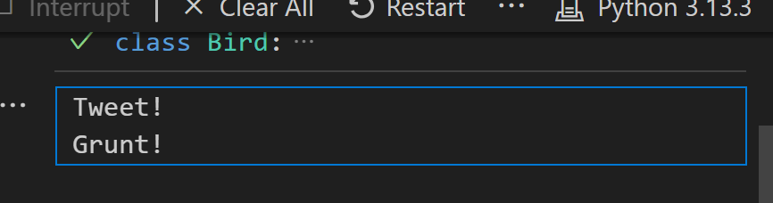
Polymorphism Bird Example in Python
class Bird:
def make_sound(self):
print("Tweet!")
class Emu(Bird):
def make_sound(self):
print("Grunt!")
def speak(bird):
bird.make_sound()
speak(Bird()) # Output: Tweet!
speak(Emu()) # Output: Grunt!
This Python code shows polymorphism, where different bird objects respond to the same make_sound() method in their own unique way.

Slide 34
Object-Oriented Design (OOD)
What is OOD?
It’s how we plan software using objects, their data, and their actions
Helps make code easier to build, test, and maintain

Slide 35
Object-Oriented Design (OOD)
Key Steps:
Find the classes (from real use cases)
List their attributes (nouns) and methods (verbs)
Show how they relate
Draw a UML class diagram

Slide 36
Object-Oriented Design (OOD)
Australian Example:
Designing a MyGov login system:
Classes: User, Account, Authenticator
Methods: login(), validateOTP()
"A Customer uses the deposit() method, but it's defined in the Account class."

Slide 37
Object-Oriented Design (OOD)
Australian Example:
Designing a MyGov login system:
Classes: User, Account, Authenticator
Methods: login(), validateOTP()
"A Customer uses the deposit() method, but it's defined in the Account class."

Slide 38
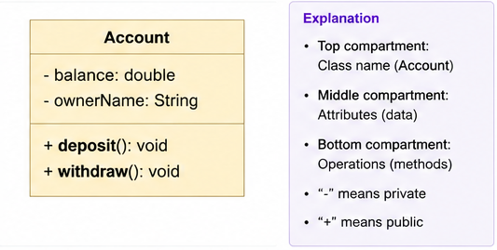
Understanding UML Class Diagrams (Account Example) – Java Style Notation
What is UML?
UML = Unified Modeling Language
Used to draw diagrams that show how classes are built and how they relate
- means private
+ means public

Slide 39
Recommended Tools for Drawing UML Diagrams
Tools You Can Use:
Draw.io
Visual Paradigm (free)
Lucidchart
Microsoft Visio
These tools help you create class diagrams, use case diagrams, and more—free and beginner-friendly.

Slide 40
Tool | Description | Platform | Best For | Link
Draw.io (diagrams.net) | Intuitive, browser-based diagramming tool with UML templates. | Web, Desktop | Class Diagrams, Use Case Diagrams, Flowcharts | https://draw.io
Lucidchart (Free Plan) | Easy-to-use interface with real-time collaboration and UML templates. | Web | UML diagrams, Use Case design, Group work | https://www.lucidchart.com
Visual Paradigm (Community Edition) | Professional UML and system modeling tool with rich diagram support. | Desktop (Windows/macOS/Linux) | Class Diagrams, Sequence Diagrams, DFDs | https://www.visual-paradigm.com/download/community.jsp
StarUML (Free Trial or License) | Designed for software engineering students and professionals. | Desktop | Full UML diagram suite (recommended in course) | https://staruml.io
Creately (Free Tier) | Collaborative visual workspace with multiple UML templates. | Web | Use Cases, Class Diagrams, ERDs | https://creately.com

Slide 41
Recommendation for Students
Beginner-friendly: Start with Draw.io or Lucidchart.
Professional-level UML modelling: Use StarUML or Visual Paradigm.
Offline work: Prefer Visual Paradigm or StarUML desktop versions.
Collaboration features: Use Lucidchart or Creately (great for group projects).

Slide 42
Using Microsoft Visio for UML Diagrams
Microsoft Visio is a powerful diagramming tool that can be used to draw a variety of system and software models, including UML diagrams.
Visio is suitable for creating:
Use Case Diagrams
Class Diagrams
Activity Diagrams
Sequence Diagrams

Slide 43
Using Microsoft Visio for UML Diagrams
However, please note:
Feature | Details
Installation | Part of Microsoft 365 (Pro Plus or Enterprise editions)
License | May require separate license or institutional access
Suitability for Beginners | Moderate (not as intuitive as Draw.io or StarUML)
Export Options | Easily export to PDF or image formats
UML Templates | Available via built-in or downloadable stencils

Slide 44
Using Microsoft Visio for UML Diagrams
If your university provides Microsoft 365 for Education:
Visit your university's Office 365 portal, e.g. https://www.office.com
Sign in using your University email.
Click on "Install Office".
If Visio is included in your license, you will see an option to install Visio under “Other installs”.
Not all student accounts include Visio by default. Check with your university IT or library services.

Slide 45
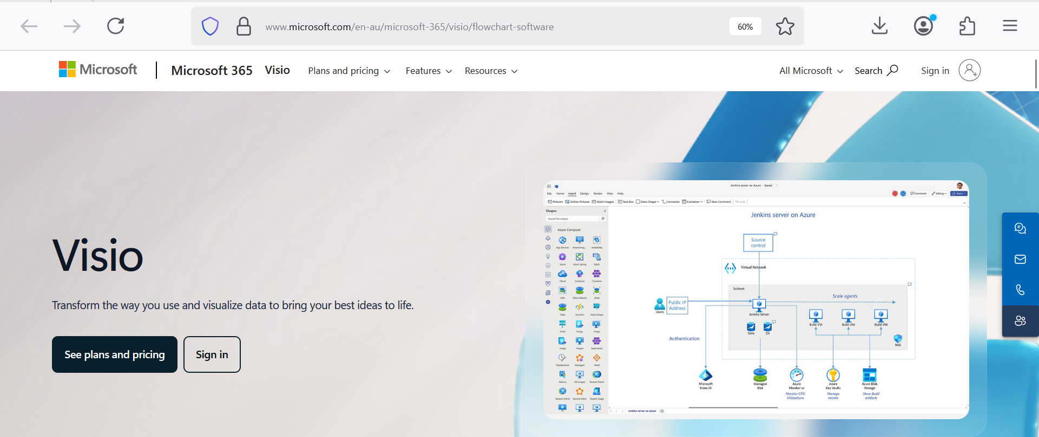
Using Microsoft Visio for UML Diagrams
To download Visio as a standalone app (if not included in your student license):
https://www.microsoft.com/en-au/microsoft-365/visio/flowchart-software
This is the official Microsoft Visio page. Scroll down to compare Visio Plan 1 (web only) and Plan 2 (includes desktop app).

Slide 46
Using Microsoft Visio for UML Diagrams
Tip for Students
Visio Plan 1 is browser-based and lightweight (monthly subscription).
Visio Plan 2 includes the full desktop version and is ideal for UML diagrams and complex modelling tasks.

Slide 47
Lab 2 Exercises
Complete the Lab 2 exercises as a team
(form groups of 3-4 students)
Lab 2 continues from Lab 1

Slide 48
Lab 2 Exercises
Canvas >> Modules >> Lab 2: Object-Oriented Design
Lab 2: Object-Oriented Design
Lab 2 aims to further enhance your software design knowledge through activities that cover the following key topics:
Object-oriented design
Organizing a program into classes
Identify the design layers (abstraction, implementation, interactions)
Identify inheritance within the system
Class diagram
Visual the OO Design into UML class diagram representation

Slide 49
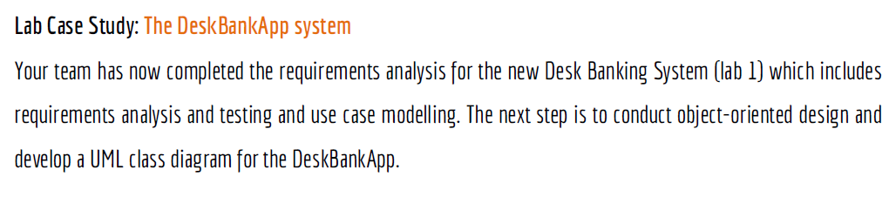
Lab 2 Exercises

Slide 50
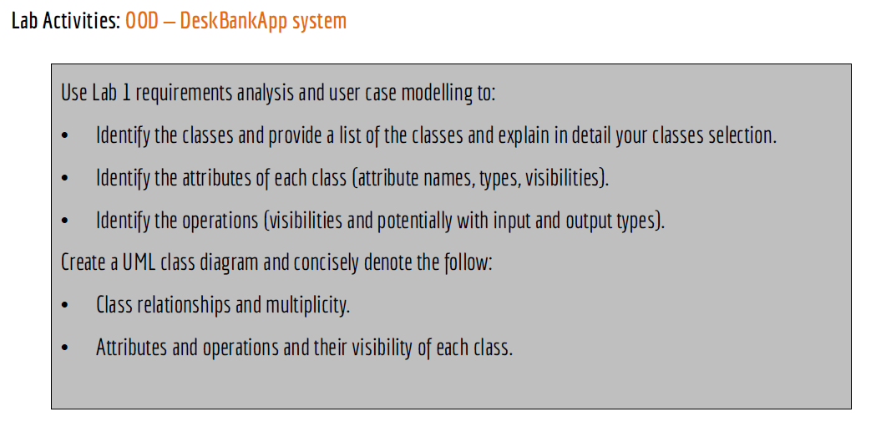
Lab 2 Exercises

Slide 51
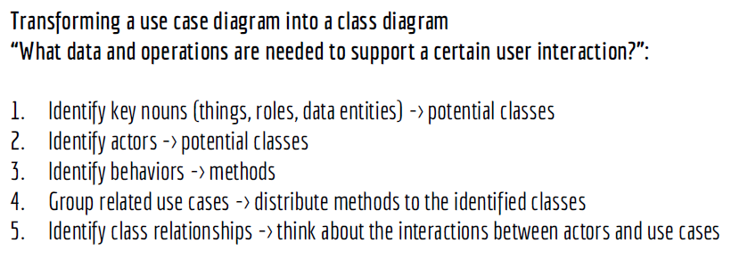
Lab 2 Exercises

Slide 52
Lab 2 Exercises
Lab Tools:
The following tools are recommended to complete lab 2 activities:
Download and use Visual Paradigm Community Edition
Use the online drawing tool: draw.io
Feel free to use other tools of choice!

Slide 53
Lab 2 Exercises
Lab Case Study: The DeskBankApp system
Your team has now completed the requirements analysis for the new Desk Banking System (lab 1) which includes requirements analysis and testing and use case modelling. The next step is to conduct object-oriented design and develop a UML class diagram for the DeskBankApp.

Slide 54
Lab 2 Exercises
Lab Activities: OOD – DeskBankApp system
Use Lab 1 requirements analysis and user case modelling to:
Identify the classes and provide a list of the classes and explain in detail your classes selection.
Identify the attributes of each class (attribute names, types, visibilities).
Identify the operations (visibilities and potentially with input and output types).
Create a UML class diagram and concisely denote the follow:
Class relationships and multiplicity.
Attributes and operations and their visibility of each class.

Slide 55
Lab 2 Practical Steps
Transforming a use case diagram into a class diagram
“What data and operations are needed to support a certain user interaction?”:
Identify key nouns (things, roles, data entities) -> potential classes
Identify actors -> potential classes
Identify behaviors -> methods
Group related use cases -> distribute methods to the identified classes
Identify class relationships -> think about the interactions between actors and use cases
Notes:
Each use case often maps to one or more methods in a class
If we look at the make a payment use case, as the payment is made from an account to another one, it makes sense to implement the pay method in the account class.

Slide 56
Lab 2: Interactive Questions
Question 1) What is the goal of Lab 2?
Think about what we are trying to achieve after completing the requirements analysis.
The goal of Lab 2 is to convert the requirements and use case diagram into an Object-Oriented Design (OOD).
By the end of this lab, you should be able to:
Identify classes
Identify attributes
Identify operations (methods)
Identify relationships
Draw a UML Class Diagram

Slide 57
Lab 2: Interactive Questions
Question 2) What is Object-Oriented Design (OOD)?
Object-Oriented Design (OOD) is the process of designing software using objects and classes.
Instead of thinking about individual functions, we think about:
Objects
Their data (attributes)
Their behaviour (methods)
How they work together
Example:
Instead of writing one large banking program,
we divide it into classes such as:
Customer
Account
Transaction
Manager

Slide 58
Lab 2: Interactive Questions
Question 3) Why do we organise a program into classes?
Organising a program into classes makes software:
Easier to understand
Easier to maintain
Easier to reuse
Easier to test
Easier to extend
Example
Instead of storing everything in one program,
we separate responsibilities.
Customer manages customer information.
Account manages account information.
Transaction manages banking transactions.

Slide 59
Lab 2: Interactive Questions
Question 4) What are the design layers?
Software can be viewed in three design layers.
1. Abstraction
"What should the system do?"
Example
Customer
Account
Transaction

Slide 60
Lab 2: Interactive Questions
2. Implementation
"How is it programmed?"
Example
Java
Python
Methods
Variables

Slide 61
Lab 2: Interactive Questions
3. Interaction
"How do the objects communicate?"
Example
Customer → Account → Transaction

Slide 62
Lab 2: Interactive Questions
Question 5) What is a class?
A class is a blueprint for creating objects.
A class contains:
Attributes (data)
Operations (methods)
Example: Customer
Attributes
customerID
name
email
Methods
login()
logout()
viewAccounts()

Slide 63
Lab 2: Interactive Questions
Question 7) How do we identify classes?
Read the requirements carefully.
Look for important nouns.
Example
Requirement: Customer can deposit money into an account.
Possible classes
Customer
Account
Transaction
Nouns often become classes.

Slide 64
Lab 2: Interactive Questions
Question 8) Which classes can we identify for DeskBankApp?
Possible classes include:
Customer
Account
Transaction
Manager
Employee
Branch
Depending on the design, additional supporting classes may also be identified.

Slide 65
Lab 2: Interactive Questions
Question 9) Why is "Deposit" not a class?
A deposit is an action, not a thing.
Classes usually represent things.
Methods usually represent actions.
Java example
public void deposit(double amount) {
balance = balance + amount;
}
Python example
def deposit(self, amount):
self.balance = self.balance + amount
Here, deposit() is a method inside the Account class.
Remember:
Account → class (thing)
deposit() → method (action)
amount → method parameter (input)

Slide 66
Lab 2: Interactive Questions
Question 10) How do we identify attributes?
Think about the information each class needs.
Example
Customer
customerID
fullName
email
phone
Account
accountNumber
balance
accountType

Slide 67
Question 11) What is an attribute?
An attribute is data stored inside a class.
Attributes describe the objects created from the class.
Java example
class Account {
private String name;
private double balance;
}
Python example
class Account:
def __init__(self, name, balance):
self.name = name
self.balance = balance
In both examples:
name stores the account holder’s name.
balance stores the amount of money in the account.
Each Account object can have a different name and balance.

Slide 68
Lab 2: Interactive Questions
Question 12) What is a method (operation)?
A method describes what an object can do.
Example
Customer
login()
logout()
viewAccounts()
Account
deposit()
withdraw()
getBalance()
Methods are usually written using verbs.

Slide 69
Lab 2: Interactive Questions
Question 13) What is visibility?
Visibility controls who can access data or methods.
Symbol | Meaning
+ | Public
- | Private
# | Protected
Example
- balance : double
+ deposit()
+ withdraw()
Private data protects the object.

Slide 70
Lab 2: Interactive Questions
Question 14) What is inheritance?
Inheritance allows one class to reuse another class.
Example
Employee → Manager
A Manager is an Employee.
The Manager inherits common attributes and methods from Employee.

Slide 71
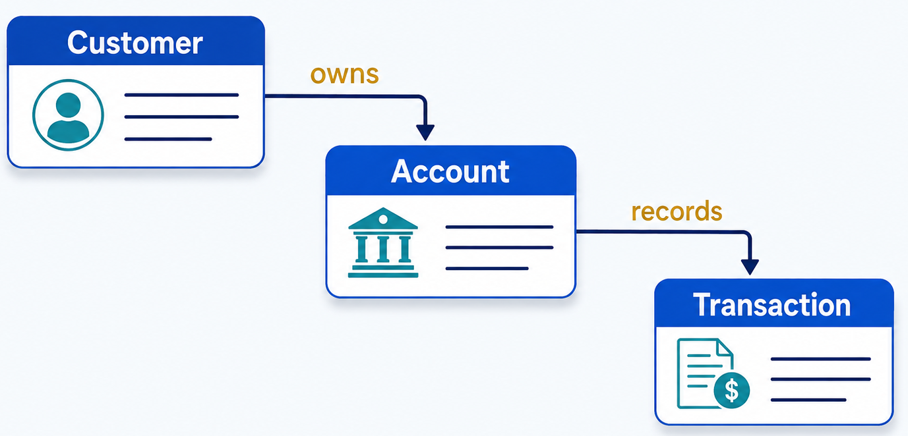
Lab 2: Interactive Questions
Question 15) What is a class relationship?
Classes communicate with one another.
Example
Relationships help describe how objects interact.

Slide 72
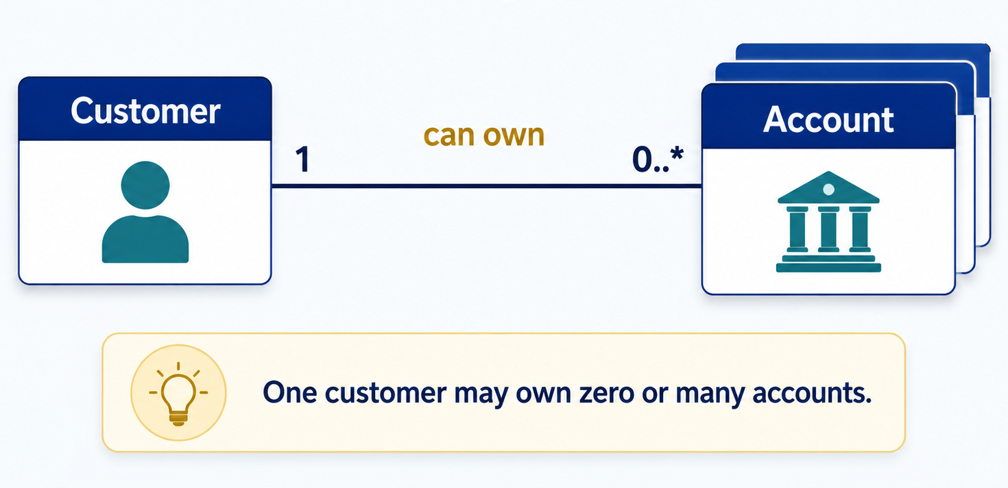
Question 16) What is multiplicity?
Multiplicity tells us how many objects participate in a relationship.
Example

Slide 73
Lab 2: Interactive Questions
Question 17) How do we transform a Use Case Diagram into a Class Diagram?
Show the transformation steps:
Read the use cases.
Identify nouns → potential classes.
Identify actors → potential classes.
Identify behaviours → methods.
Identify data → attributes.
Identify relationships.
Add multiplicity.
Draw and review the UML class diagram.

Slide 74
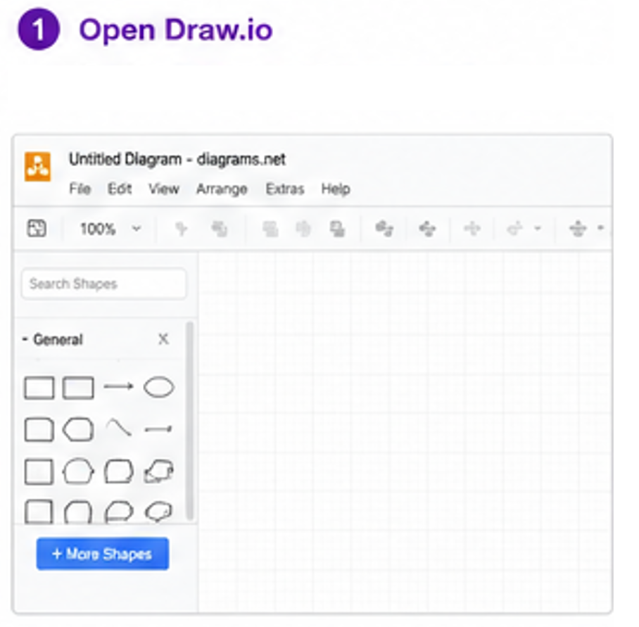

Slide 75
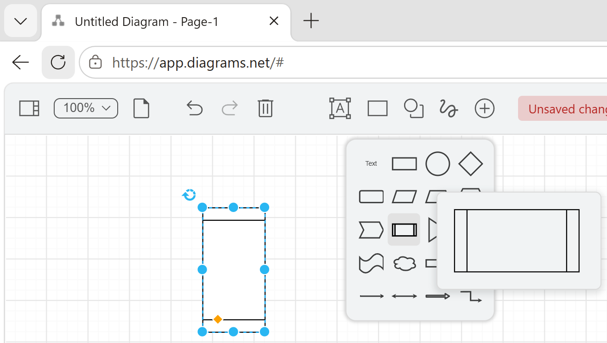
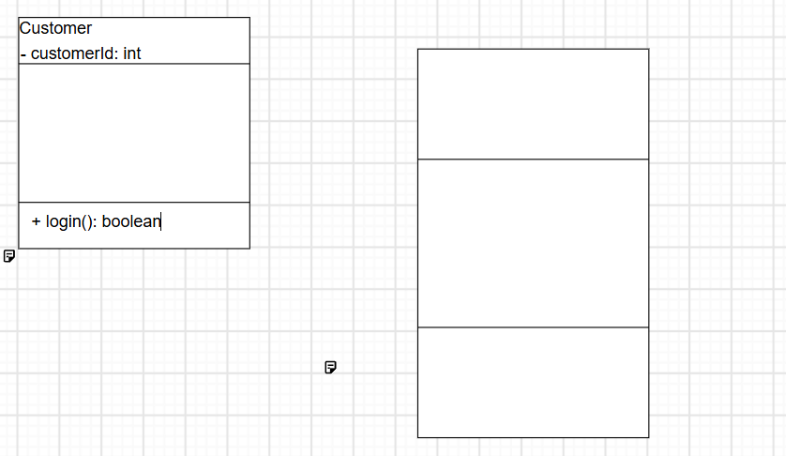

Slide 76
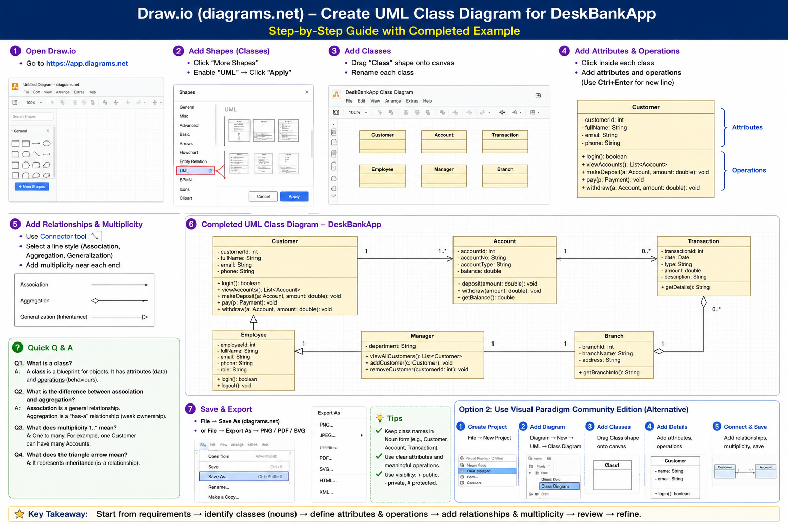

Slide 79
1. Association
What is it?
An association means that two classes are connected or work together.
They know about each other, but one does not own the other.
Example) Customer -------- Account
Meaning
A customer owns or uses an account.
The customer and account are related.
Real-world example
Teacher ↔ Student
Doctor ↔ Patient
Customer ↔ Account
Easy way to remember Association = "works with" or "uses".

Slide 80
2. Aggregation
What is it?
An aggregation means one object has another object, but the second object can still exist on its own.
This is a weak "has-a" relationship.
Example
Branch ◇──────── Customer
Meaning
A branch has many customers.
If the branch closes, the customers still exist.
Another example
University ◇── Student
If the university closes,
the students still exist.
Easy way to remember
Aggregation = "has-a" (weak ownership). The part can live without the whole.

Slide 81
3. Generalization (Inheritance)
What is it?
Generalization means one class inherits from another class.
The child class automatically receives the parent's attributes and methods.
Example: Kangaroo -- Animal
Meaning
A Kangaroo is an Animal.
Kangaroo inherits:
eat()
breathe()
sleep()
and adds its own method:
jump()

Slide 82
Another example
Employee – Manager
Meaning
A Manager is an Employee.
The Manager inherits employee information and can also perform additional tasks.
Easy way to remember
Inheritance = "is-a".
A Manager is an Employee.
A Dog is an Animal.
A Kangaroo is an Animal.

Slide 83
Quick Comparison
Relationship | Meaning | Example
Association | Works with | Customer ↔ Account
Aggregation | Has a (weak ownership) | Branch ◇── Customer
Generalization (Inheritance) | Is a | Manager △ Employee

Slide 84
Simple Memory Trick
Relationship | Remember this phrase
Association | Works with
Aggregation | Has a
Generalization | Is a

Slide 85
Q1. Which relationship should be used between Customer and Account?
Association
Because a customer uses or owns an account.
Q2. Which relationship should be used between Branch and Customer?
Aggregation
A branch has many customers, but customers still exist even if the branch closes.
Q3. Which relationship should be used between Manager and Employee?
Generalization (Inheritance)
A manager is a specialised employee.

Slide 86
Q4. Which relationship should be used between Kangaroo and Animal?
Generalization (Inheritance)
A kangaroo is an animal.
Key Takeaway
Association → Classes work together.
Aggregation → One class has another class, but the second class can exist independently.
Generalization (Inheritance) → One class is a specialised version of another class and inherits its attributes and methods.

Slide 88
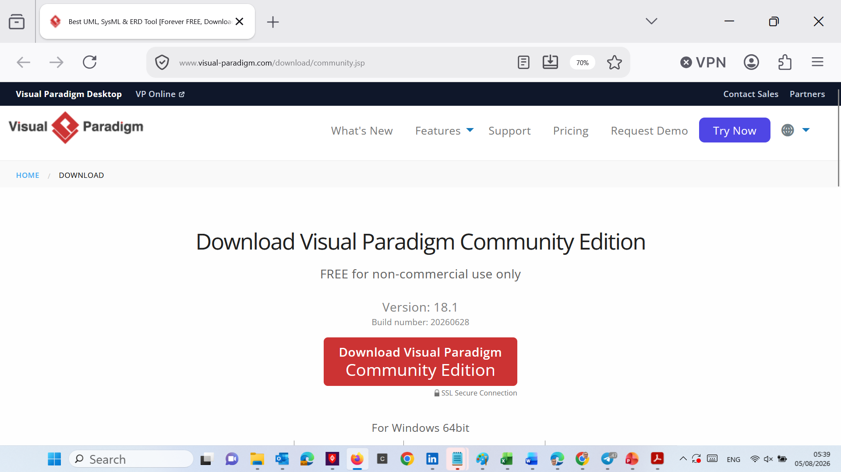
Alternative tool: Visual Paradigm Community Edition

Slide 89
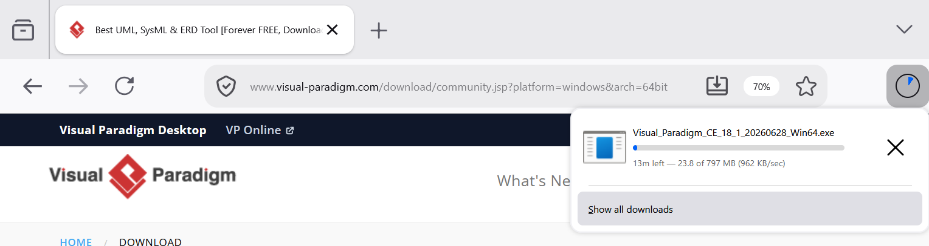
Alternative tool: Visual Paradigm Community Edition

Slide 90
Alternative tool: Visual Paradigm Community Edition

Slide 91
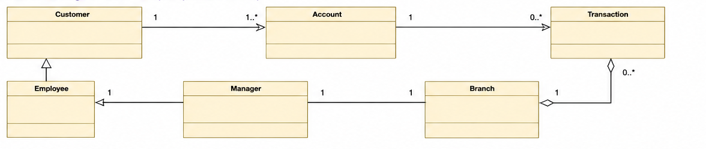
Partial UML Class Diagram – Group Design Challenge
Complete the classes and critically review the proposed relationships.
This diagram is intentionally incomplete, and some relationships may need to be changed or removed. Do not assume that everything shown is correct. Use the DeskBankApp requirements to justify your design decisions.
Your task is not only to fill in the class boxes. You must also decide whether each class, relationship and multiplicity is justified.

Slide 92
Your Group Task — 10–15 Minutes
Using the partial UML class diagram and the DeskBankApp requirements, work with your group to:
Add suitable attributes and data types to each class.
Add appropriate operations (methods), including parameters and return types where needed.
Apply UML visibility symbols:
- private
+ public
# protected

Slide 93
Review the proposed relationships and decide whether any should be added, changed, or removed.
Add suitable multiplicities, such as 1, 0..*, or 1..*.
Check that every design decision is supported by the requirements.
Be ready to explain
Why you selected each class.
Why each attribute and method belongs in that class.
Why each relationship and multiplicity is appropriate.
There may be more than one acceptable design, but your decisions must be clearly justified.

Slide 94
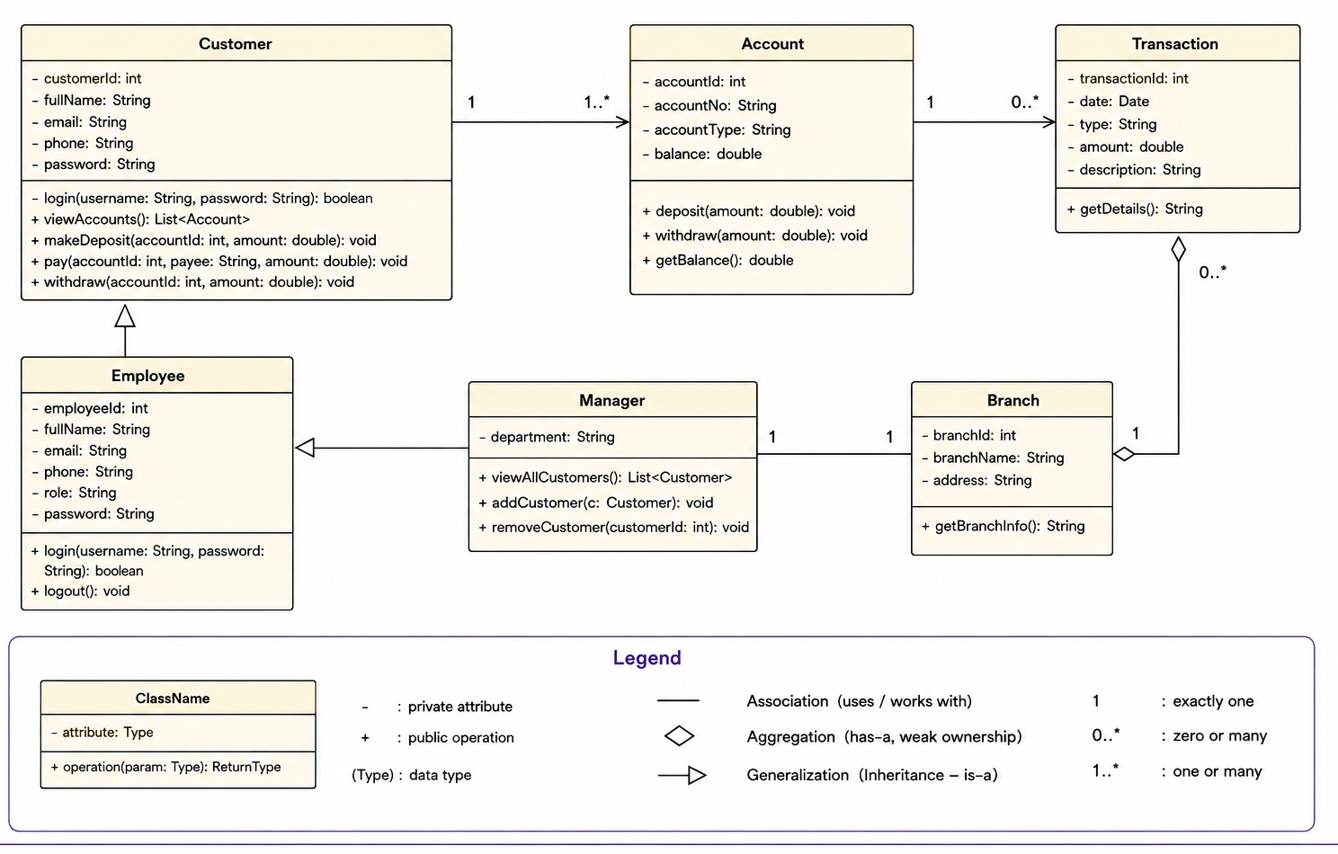
Worked Example: UML Class Diagram for DeskBankApp

Slide 95
Customer Class
Question) What does the Customer class represent?
The Customer class stores information about each bank customer.
Attributes (Data)
customerId
fullName
email
phone
These attributes describe a customer.
Operations (Methods)
login()
viewAccounts()
makeDeposit()
pay()
withdraw()
These methods describe what a customer can do.

Slide 96
Which of these are data?
customerId
fullName
email
phone
Which are actions?
login()
withdraw()
deposit()

Slide 97
2. Account Class
Question) Why do we need an Account class?
A customer can own one or more bank accounts.
The Account class stores information about each account.
Attributes
accountId
accountNumber
accountType
balance
Methods
deposit()
withdraw()
getBalance()

Slide 98
Where should the balance be stored?
Inside the Account class.
3. Transaction Class
Question) Why do we need a Transaction class?
Every banking activity should be recorded.
Examples
Deposit
Withdrawal
Payment
The Transaction class stores these records.
Attributes
transactionId
date
type
amount
description

Slide 99
Can one account have many transactions?
Yes.
4. Employee Class
Question) Why is Employee a separate class?
Employees use the system differently from customers.
Employees can
log in
log out
The Employee class stores employee information.

Slide 100
5. Manager Class
Question) What is special about the Manager class?
A manager is a specialised employee.
Managers can
View all customers
Add customers
Remove customers
Managers have more permissions than ordinary employees.

Slide 101
Can every employee remove customers?
No.
Only the Manager.
6. Branch Class
Question) Why do we need a Branch class?
The system is installed in bank branches.
Each branch stores
branchId
branchName
address

Slide 102
Understanding the Relationships
Relationship 1
Customer → Account
Question) What does this relationship mean?
A customer owns one or more accounts.
Multiplicity
1 -------- 1..*
Meaning
One customer has one or many accounts.

Slide 103
Can two customers share one account?
Depending on the system design,
Yes (joint account)
or
No
Always check the requirements.

Slide 104
Relationship 2
Account → Transaction
Question) Why is Account connected to Transaction?
Each account keeps a history of transactions.
Examples
Deposit → Transaction
Withdraw → Transaction
Payment → Transaction
Multiplicity
1 -------- 0..*
Meaning: One account may have many transactions.

Slide 105
Relationship 3
Employee ← Manager
Question) What does the triangle mean?
It represents Inheritance.
Manager → is an → Employee
A manager inherits common employee information.

Slide 106
What information can Manager inherit?
employeeId
fullName
email
phone
Relationship 4) Manager → Branch
Question) Why is Manager connected to Branch?
A manager works at a branch.
One manager manages one branch.
One branch has one manager.
(Depending on the system design.)

Slide 107
Relationship 5
Branch ◇── Transaction
Question) What does the white diamond mean?
The white diamond represents aggregation.
Aggregation means a has-a relationship with weak ownership.
Example
A branch has many transactions.
If the branch is removed from the diagram, the transaction records may still exist independently.

Slide 108
Understanding Multiplicity
Question) What do these numbers mean?
1
Exactly one.
0..*
Zero or many.
1..*
One or many.
Example
Customer -> 1 -> Account -> 1..*
Meaning: One customer owns one or more accounts.

Slide 109
Review Questions) Q1
Which class stores the customer's balance?
Account
Q2) Which class stores deposits and withdrawals?
Transaction
Q3) Which class has methods such as deposit()?
Account
Q4) Which class can add customers?
Manager
Q5) Which relationship represents inheritance?
Manager → Employee

Slide 110
Q6) What does 1..* mean?
One or many.
Final Discussion) Is this the only correct UML Class Diagram?
No.
Software design is not always unique.
Different teams may produce different class diagrams.
As long as the design:
satisfies the requirements,
uses appropriate classes,
defines sensible relationships,
and can be justified,
it may still be a correct solution.

Slide 111
Lab 2: Interactive Questions
Question 18) Which use case creates the method deposit()?
Use case
Make Deposit → Method
deposit(amount)
The use case becomes behaviour inside the Account class.
The Make Deposit use case describes an action performed by the user. This action becomes a method inside the Account class.

Slide 112
Java example
class Account {
private double balance;
public void deposit(double amount) {
balance = balance + amount;
}
}
Example use
Java
account.deposit(100.00);
Python example
class Account:
def __init__(self):
self.balance = 0.0
def deposit(self, amount):
self.balance = self.balance + amount
Python
account.deposit(100.00)
Both examples add $100.00 to the account balance.

Slide 113
Lab 2: Interactive Questions
Question 19) Why don't we copy the Use Case Diagram directly?
A Use Case Diagram answers: What should the system do?
A Class Diagram answers: How is the software organised?
They represent different views of the same system.

Slide 114
Lab 2: Interactive Questions
Question 20) Before submitting your UML Class Diagram, what should you check?
✔ Have you identified all important classes?
✔ Does every class have meaningful attributes?
✔ Does every class have useful methods?
✔ Are visibility symbols included?
✔ Are relationships shown?
✔ Are multiplicities included?
✔ Are inheritance relationships shown where appropriate?
✔ Is the diagram neat and easy to read?

Slide 115
Final Discussion Question) Imagine you are the software architect.
Can you think of any additional classes that would improve DeskBankApp?
Possible ideas:
Loan
CreditCard
ATM
LoginService
Authentication
Receipt
Payment
Notification
There may be multiple correct answers, provided students can justify why the class is needed and how it supports the system requirements.

Slide 116
Lab 2: Interactive Questions
Reflection Question) Wrap-Up
What is the difference between a class and an object?
Why do we use classes instead of one large program?
How do use cases help us identify classes?
What is the purpose of attributes and methods?
Why are relationships and multiplicity important in a UML class diagram?
If the bank later adds a Loan feature, which new classes might you introduce?

Slide 117

Let’s Answer Your Questions
Canvas Inbox – For academic queries.
Email – For formal communication and attachments.
Canvas Discussion – For academic discussions and general queries.
Reminder – Please follow up if you do not receive a response within 3 business days.

Slide 118

Happy Learning and Bright Futures Ahead! Dr. Farshid Keivanian Stay Connected: linkedin.com/in/farshid-keivanian github.com/FarshidKeivanian
Education is the most powerful weapon you can use to change the world. — Nelson Mandela

